Slide 1








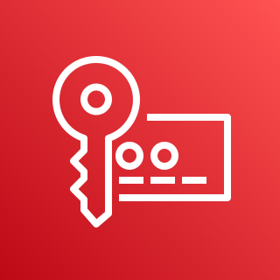

AWS Cloud
Organization Management Account
Log Archive Account
OU: Security
Organization CloudTrail
Config Management
Solution Log and Finding S3 Buckets
Audit Account
OU: Security
All Accounts
Delegated Administrator Account
Security Hub Member
AWS Shield
Advanced
Security Hub
Guard Duty
Config Organization Conformance Packs
Guard Duty Member
AWS WAF
AWS Key Management Service (AWS KMS)
AWS Shield
Advanced
AWS Firewall Manager
AWS Key Management Service (AWS KMS)

